Slide 1

Vel Tech Rangarajan Dr. Sagunthala R&D Institute of Science and Technology
School of Computing
Department of Computer Science and Engineering
10211CS224 / FULL STACK APPLICATION DEVELOPMENT (JAVA)
PROJECT REVIEW - 2 MILESTONE PROJECT – 2
Date: 20-04-2026
SMART CAMPUS EVENT MANAGEMENT SYSTEM
SDG: SDG 4 – Quality Education
Presented By:
A.SRAVANI– VTU26587 – Reg .No . 23UECS1007
Courses Handling Faculty:
Dr-Hafizur Rahman
Assistant Professor

Slide 2
INTRODUCTION
1
In many colleges and organizations, event management is still handled manually through calls, messages, and spreadsheets.
This often leads to missed updates, confusion in scheduling, and poor participant management.
To solve these issues, we developed a Smart Campus Event Management System, which provides a centralized platform for managing events efficiently.
The system allows admin to create and edit events.
Students can browse a live feed of events and register with just one click.
Overall, it is a modern platform designed to improve event planning, coordination, and communication.
2
3
4
5
6
7
8
9

Slide 3
PROBLEM STATEMENT
1
The existing system has several challenges that affect efficiency and accuracy.
Students lack a centralized digital dashboard to track their personal registration history and schedules.
Manual registration increases workload and leads to frequent data entry mistakes.
Also, communication about schedule changes is slow and sometimes does not reach all participants.
There is no proper system to analyze event participation or generate quick reports.
Manual data management prevents the institution from generating fast and accurate attendance reports.
Existing methods lack the automation required to ensure a reliable and streamlined event management experience.
2
3
4
5
6
7
8
9

Slide 4
OBJECTIVES
1
2
The main objective of this project is to design a centralized and automated system for event management.
We aim to simplify event creation and registration processes while reducing manual work.
To implement a real-time analytics dashboard for monitoring student participation and improving overall administrative data accuracy.
Another important goal is to provide real-time updates and analytical insights to improve decision-making.
3
4
5
6
7
8
9

Slide 5
PROPOSED SYSTEM
The proposed system is a web-based application that connects administrators and students on a single platform.
Admins can easily create, update, and manage events, while students can view and register for events instantly.
By automating the registration process, it eliminates the need for manual paperwork and reduces human errors in participant tracking.
The system also ensures faster communication through automated notifications and maintains all records securely.
The platform offers superior accessibility, allowing users to register for and manage events 24/7 from any device.
Centralized data storage ensures higher security and integrity of student records compared to manual spreadsheets.
Automated confirmation and notification systems significantly enhance the speed and reliability of campus-wide communication.
1
2
3
4
5
6
7
8
9

Slide 6
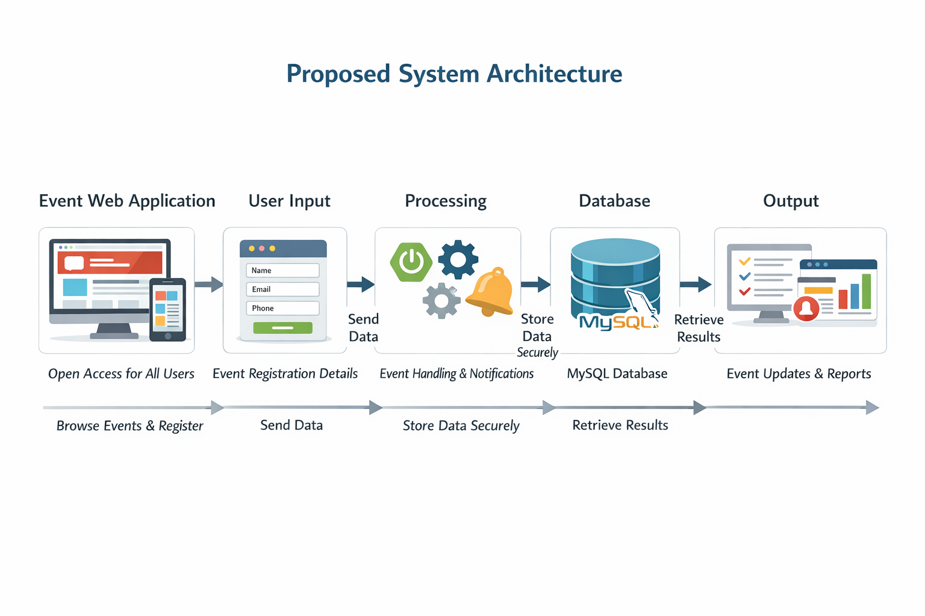
PROPOSED SYSTEM ARCHITECTURE
1
2
3
4
5
6
7
8
9

Slide 7
PROPOSED SYSTEM ARCHITECTURE
1
Input: User data such as event details, participant invitations, responses, and event updates are entered into the system.
Processing: The system processes the input by handling event creation, updating records, sending notifications, and synchronizing data in real time.
Database: All information related to users, events, participants, and status is stored securely in the database for quick access and management.
Output: The system displays updated event information, participant status, instant notifications, and synchronized results to all users.
2
3
4
5
6
7
8
9

Slide 8
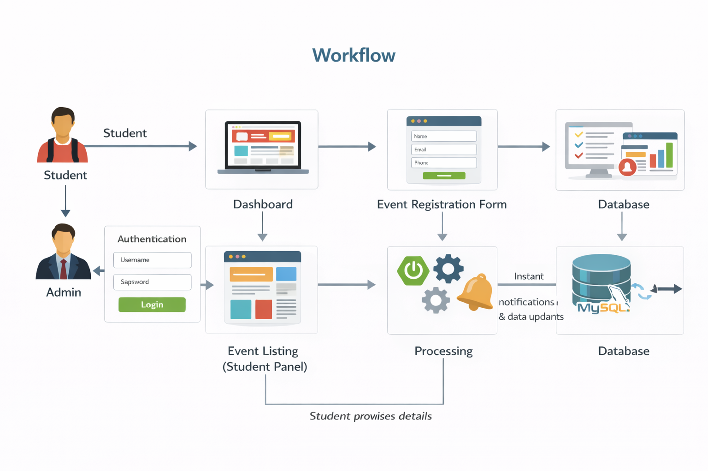
WORKFLOW
1
2
3
4
5
6
7
8
9

Slide 9
TECHNOLOGIES USED
1
Frontend: HTML5, CSS3, JavaScript
Backend: Java, Spring Boot
Database: MySQL
Tools: Visual Studio Code, Git, GitHub, Postman, Maven
Hardware/Software Requirements: Computer with minimum 4 GB RAM, dual-core processor, Node.js environment, modern web browser, and operating system such as Windows, Linux, or macOS
2
3
4
5
6
7
8
9

Slide 10
MODULE DESCRIPTION
Module 1: User Authentication and Management
Handles student registration, login, secure authentication, and basic profile-related information for accessing the system.
Module 2: Event Management
Admins can create new events, specifying date, time, venue, and descriptions..
Module 3: Administrative Control Hub
Provides administrators with tools to create, edit, or delete events and manage the comprehensive list of participant registrations.
Module 4: Analytics & Visual Reporting
Utilizes Chart.js to generate real-time visual insights into event popularity, registration trends, and student participation metrics.
1
2
3
4
5
6
7
8
9

Slide 11
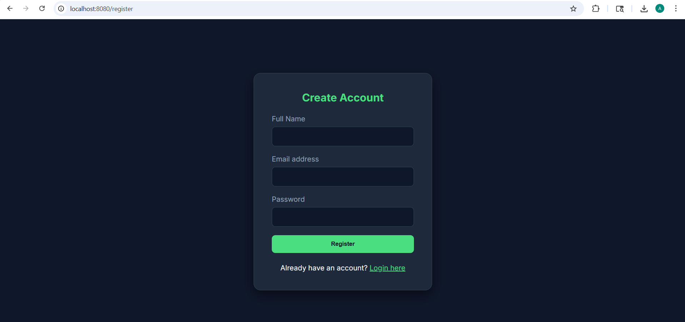
IMPLEMENTATION SCREENSHOTS
1
2
3
4
5
6
7
8
9
Image 1: Dashboard of the website with details regarding events

Slide 12
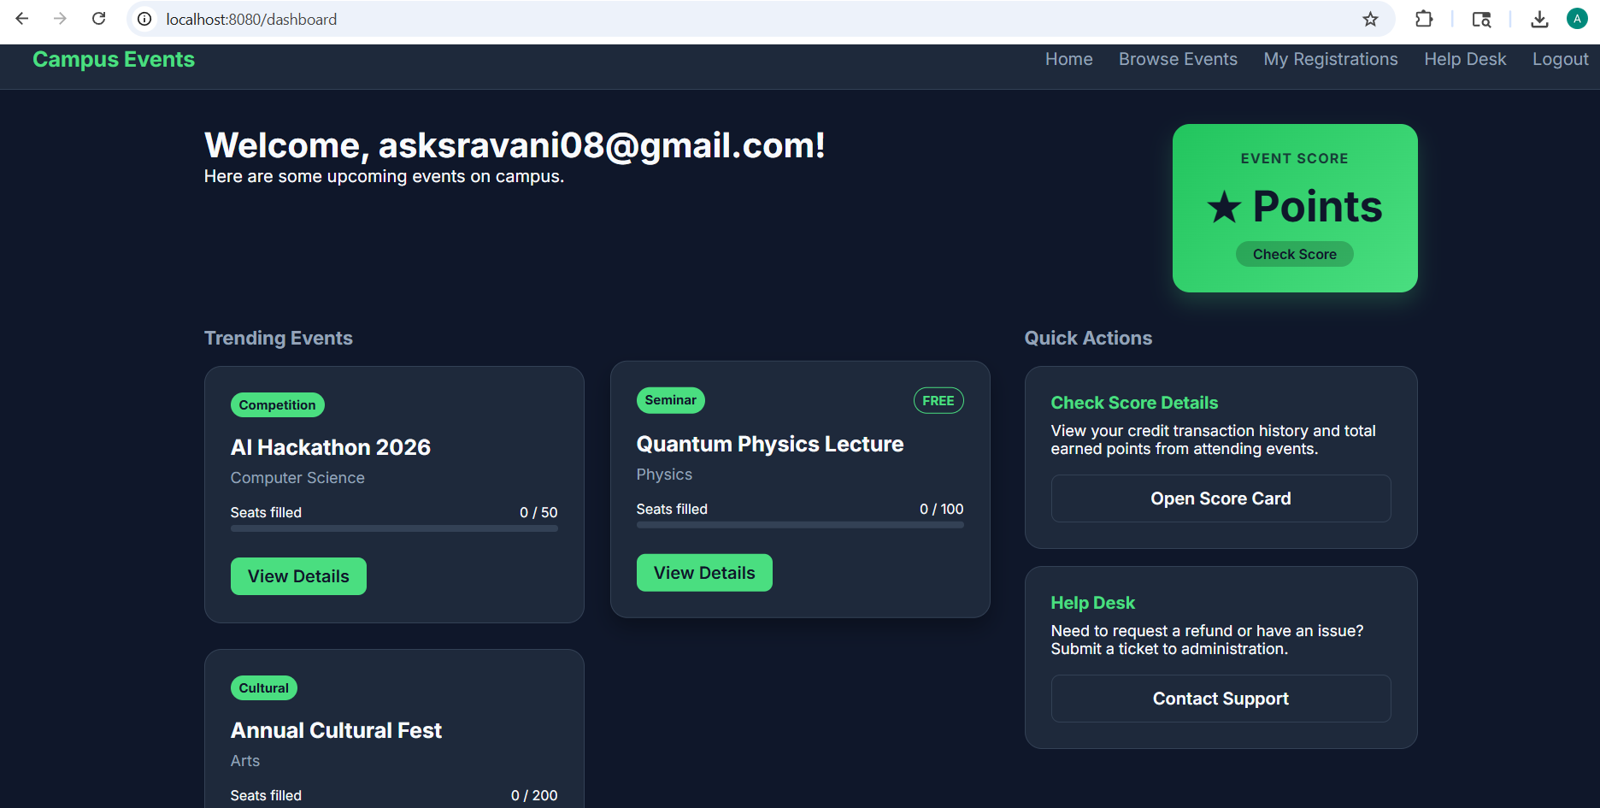
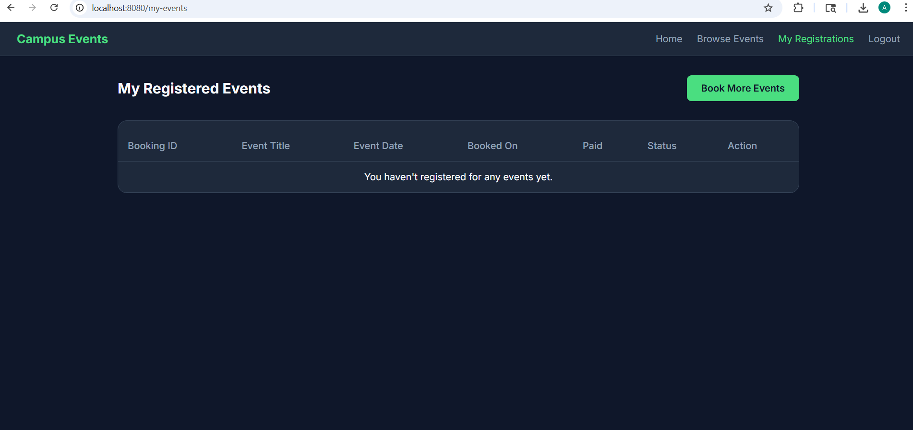
IMPLEMENTATION SCREENSHOTS
1
2
3
4
5
6
7
8(A)
9
Image 2: Events screen of the student with details regarding available events.
Image 3: Registration screen of student where they can enter credentials.

Slide 13
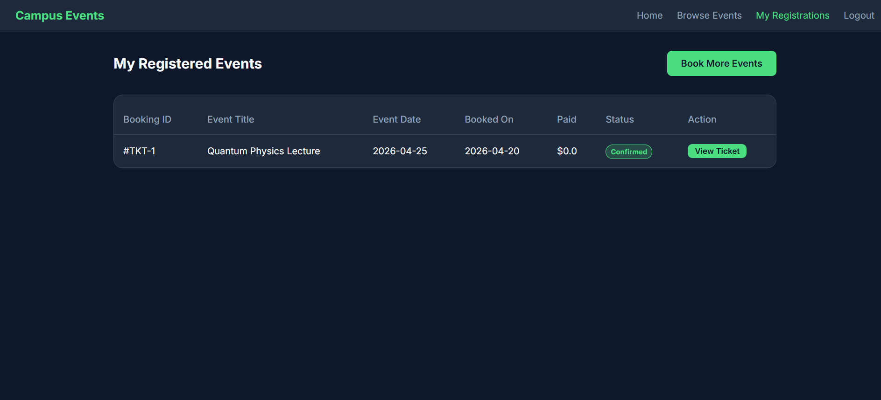
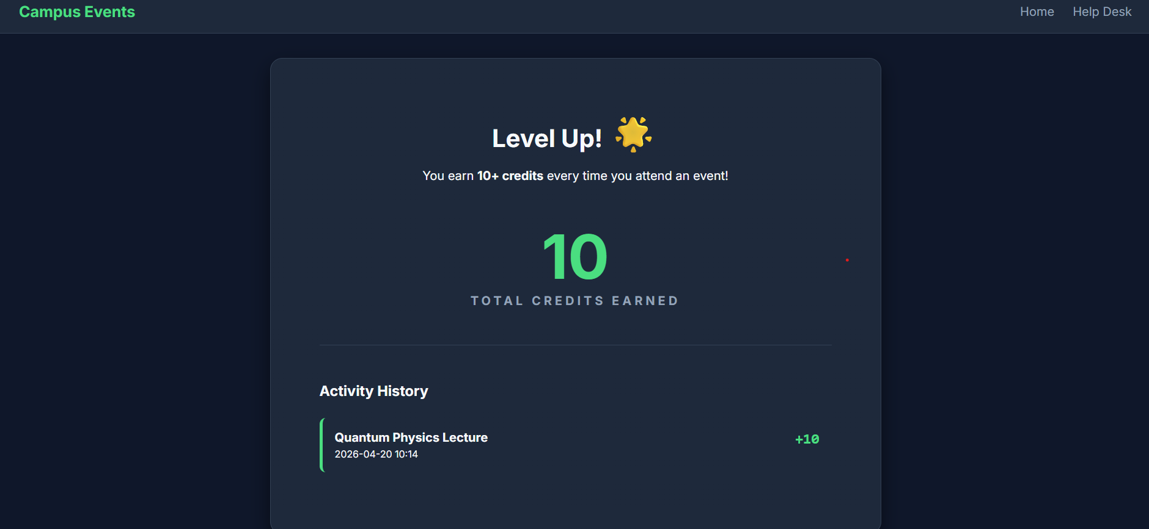
IMPLEMENTATION SCREENSHOTS
1
2
3
4
5
6
7
8(A)
9
Image 4 & 5: Events registered and score for each event

Slide 14
ADVANTAGES & LIMITATIONS
1
Advantages:
Centralization: All campus activities in one unified digital platform.
Automation: Eliminates manual paperwork and administrative errors.
Data Insights: Real-time visual tracking of student engagement.
Accessibility: 24/7 mobile-friendly registration for all students.
Limitations:
Connectivity: Requires a stable internet connection to function.
User Adoption: Effectiveness depends on institutional-wide usage.
Maintenance: Needs regular updates for data security and privacy.
Initial Input: Requires time-consuming initial setup for event data.
2
3
4
5
6
7
8
9

Slide 15
Thank you

